Slide 1


SMART INDIA HACKATHON 2025
TITLE PAGE
Problem Statement ID – 25065
Problem Statement Title- Designing and development of an application for on spot assessment of Roof Top Rain water harvesting and artificial recharge potential and size of the RTRWH and AR.
Theme- Smart Automation
PS Category- Software
Team ID-
Team Name (Registered on portal) – Code Infantry

Slide 2
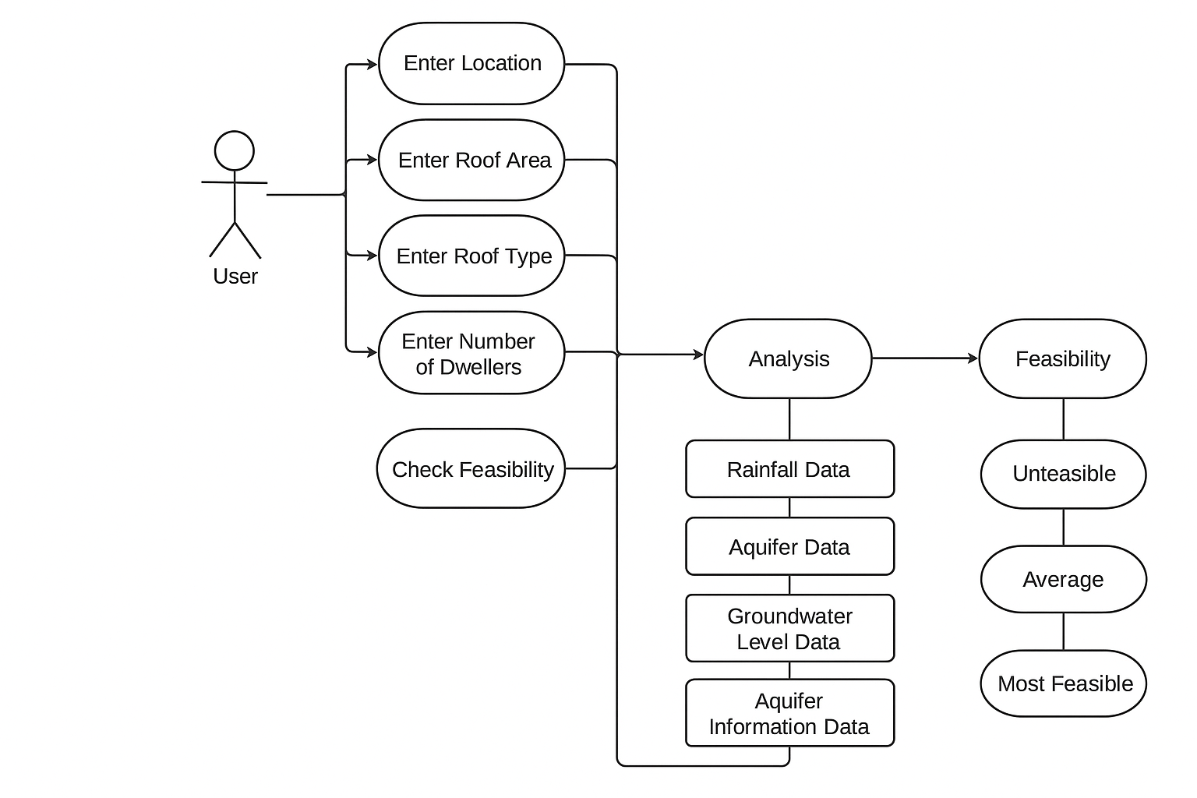

AQUALYTICS
Code
Infantry
Addressing the Problem:
UML Diagram:
Groundwater replenishment is critical for sustainable water resources.
Significant potential exists for RTRWH and AR.
No user-friendly digital platform currently exists.
Existing CGWB manuals are not easily accessible to the general public.
Lack of easy access limits public.
Proposed Solution:
Develop a web application for on-spot assessment of RTRWH and AR potential.
Users input: Name and location, Number of dwellers, Roof area and available open space
Application uses GIS-based and algorithmic models to generate personalized outputs
Feasibility check for rooftop rainwater harvesting
Recommended dimensions of recharge pits, trenches, and shafts
Suggested types of RTRWH/AR structures
Runoff generation capacity
Cost estimation and cost-benefit analysis
Innovation and Uniqueness:
On-spot digital assessment of RTRWH and AR potential.
GIS-based personalized recommendations.
Cost-benefit analysis integration
Inclusive design with support for regional languages
Transforms CGWB scientific guidelines into a practical, user-friendly tool.
Empowers individuals and communities

Slide 3
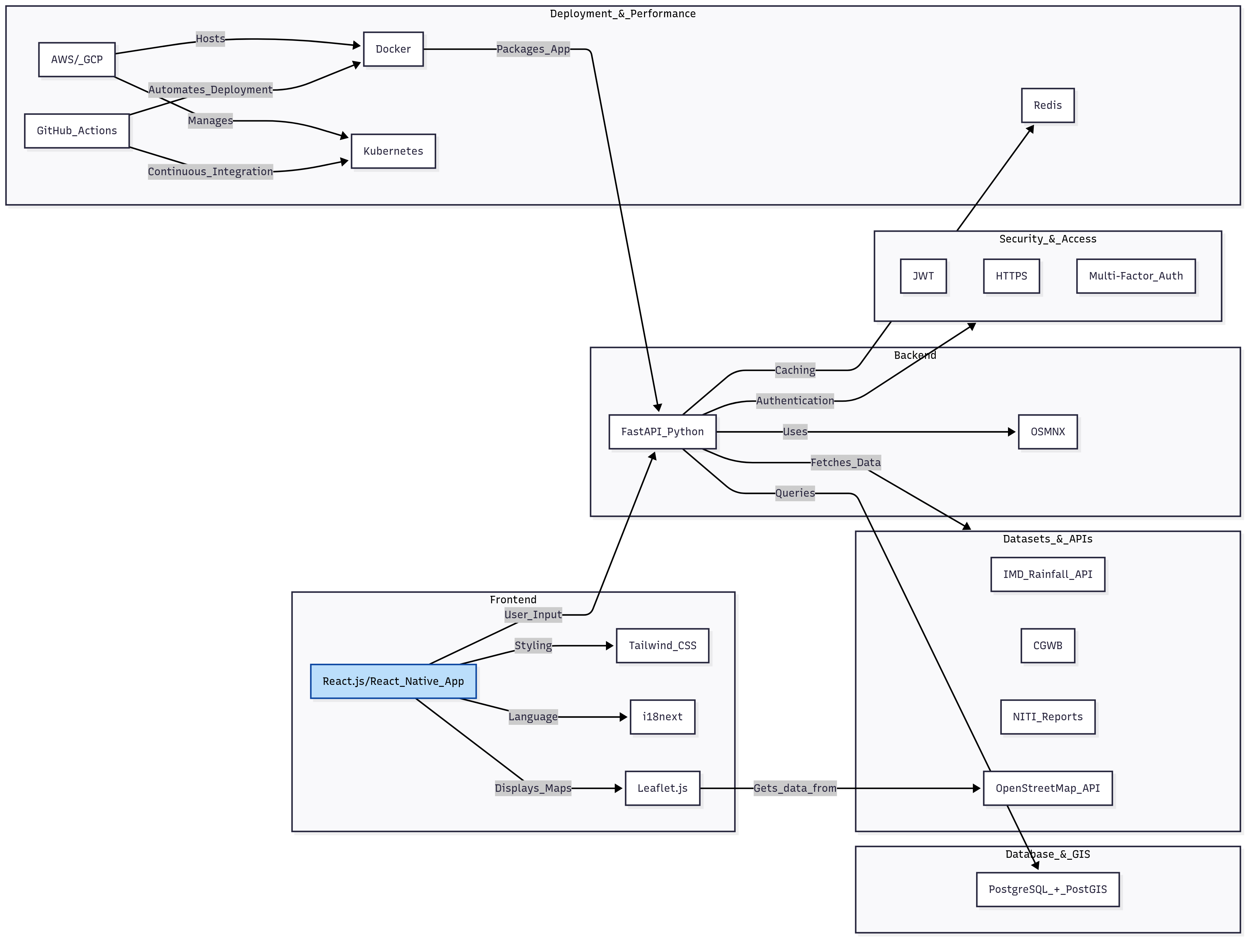


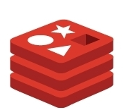





TECHNICAL APPROACH
Code
Infantry
Layered Flow Architecture:
Tech Stack and Implementation:
Presentation Layer
Application Layer
Web and mobile apps
Multilingual support
Dashboards, graphs, feasibility reports
Historical report on groundwater levels
Runoff & Recharge Models
Feasibility Analysis
Cost–Benefit Estimation
Recommendations
Security Layer
Data Layer
Authentication & Privacy
Data Encryption
Access Control
Backup & Recovery
Rainfall Data (IMD)
Groundwater Data (CGWB)
Policies, Subsidies
User Profiles & Inputs
Monitoring Layer
Infrastructure Layer
Usage Tracking
Feedback Collection
Reporting Tools
Model Validation
Cloud Hosting
Scalable Architecture
Load Balancing

Slide 4
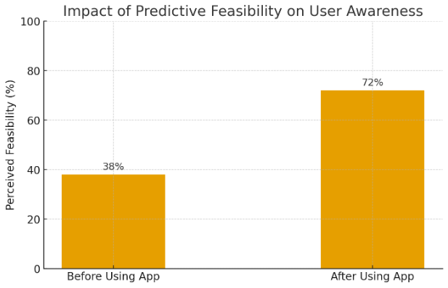
FEASIBILITY AND VIABILITY
Code
Infantry
Technical Feasibility
India has 700+ million internet users→ wide reach.
IMD’s rainfall data (1901–2024) enables precise, location-specific predictions.
Groundwater & GIS data already available via India-WRIS and CGWB → integration possible.
Economic Feasibility
Water bill savings and drought protection are proven benefits.
Cities like Pune offered tax rebates, boosting adoption → replicable nationwide.
Lower-cost structures and government schemes make RWH economically attractive
.
Environmental Feasibility
RWH recharges aquifers, reducing groundwater depletion.
Helps preventing floods and contamination.
Effective across regions with moderate to high rainfall
.
Strategies to Overcome Problems
Use detailed historical data and alerts.
Highlight savings, tax benefits, and financing options.
Automated reminders, easy-to-follow guides, and professional links can help.
Education modules, FAQs, and community success stories build confidence.
Potential Risks:
Connectivity
& literacy barriers
Maintenance challenges
Rainfall variability & data gaps
High upfront investment
Trust issues
& social resistance

Slide 5
IMPACT AND BENEFITS
Code
Infantry
Sustainable India Vision
Through inclusive design, regional language support, and scientifically guided practices, the application contributes to the national goal of a water-resilient and sustainable India.
Groundwater Replenishment
By promoting rooftop rainwater harvesting and artificial recharge structures, the solution directly supports large-scale groundwater replenishment.
Citizen Empowerment
The application will empower individuals and communities to take informed decisions about groundwater conservation and rainwater harvesting.
By utilizing local rainfall data and recommending suitable recharge structures, the solution enhances long-term water security for individuals and communities.
Water Security
Cost Savings & ROI
With features like cost estimation and cost-benefit analysis, the tool enables users to plan financially viable systems, maximizing return on investment.
Public Awareness & Participation
It will enhance public awareness, encourage participation, and support sustainable water management efforts.

Slide 6
RESEARCH AND REFERENCES
Code
Infantry
List of References:
Formulas Required for Analysis
Guides in assessing sustainable groundwater extraction and recharge potential. Estimates groundwater recharge using a water balance approach.
Rainfall Data (IMD)
Essential for estimating natural recharge and planning artificial recharge structures.
Groundwater Levels (NITI Aayog)
Monitors groundwater trends, aiding in sustainable management strategies.
Aquifer Mapping (INGRESS)
Identifies areas suitable for recharge interventions and assesses aquifer health.
Types of Recharge Trenches
Depth, width, and spacing depend on local soil and hydrological conditions.
Groundwater Resources (MoSPI)
Assists in understanding regional groundwater availability and planning recharge interventions.

